Slide 1

Operating systems
Barizs Márton Dániel
Beke Tamás
11.B

Slide 2
The operating system
There are several types of definitions:
I.
The operating system is a collection of programs that makes your computer hardware versatile, easy- and safe to use. It also provides a single interface for both the programs and the user. The operating system is often abbreviated as "OS" from the English word "operating system".
II.
The operating system is the software part of a computer, a program system that loads and controls the programs (applications) running on the computer, allocates and schedules resources, manages hardware, and provides communication between the user and the computer system.

Slide 3
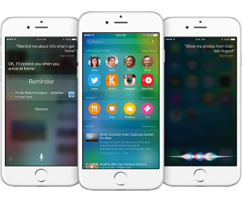
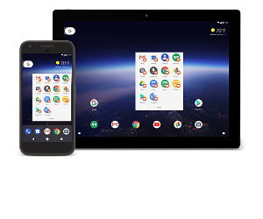
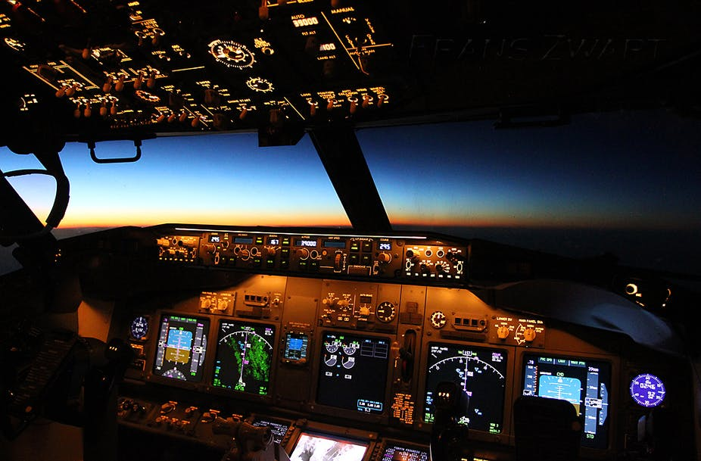
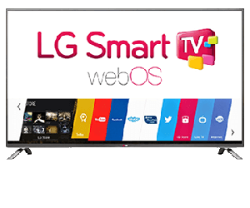
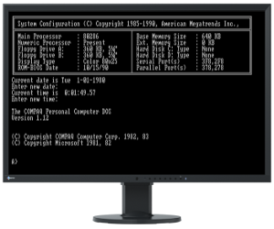
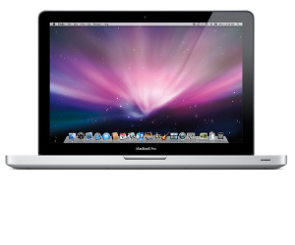
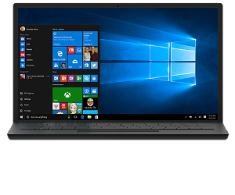
The operating system
There are many operating systems.
Operating systems are not only found in personal computers, but also in smartphones, smart TVs, cars, airplanes... etc.

Slide 4

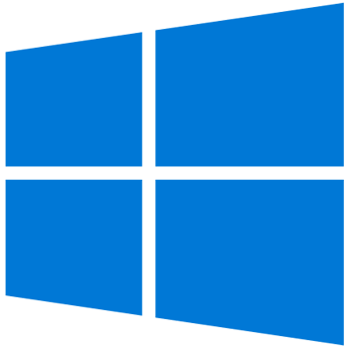
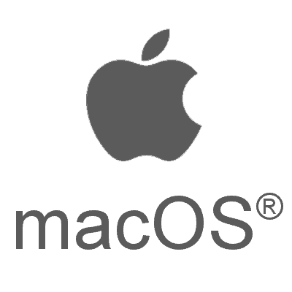
The operating system
In computer architecture, the
main purposes of the OS:
It provides comfort, efficiency and protection.
Separates applications from hardware
Parts of a layered op system:
System core (kernel)
(API: Application Programming Interface)
System shell (shell)
Service programs (Utility)

Slide 5
Tasks of the operating system
Managing and transferring data
Securely storing programs and data
Reporting and handling malfunctions
Managing networks
User Interface
Handling and operating the hardware of the machine
Running applications
Scheduling, processing, sharing resources
CPU Scheduling
Notes:
- allocate processor time between queued jobs based on some strategy
- switching between jobs
ensure communication with the user
CPU scheduling is the task performed by the CPU that decides the way and order in which processes should be executed.

Slide 6
Grouping operating systems

Slide 7
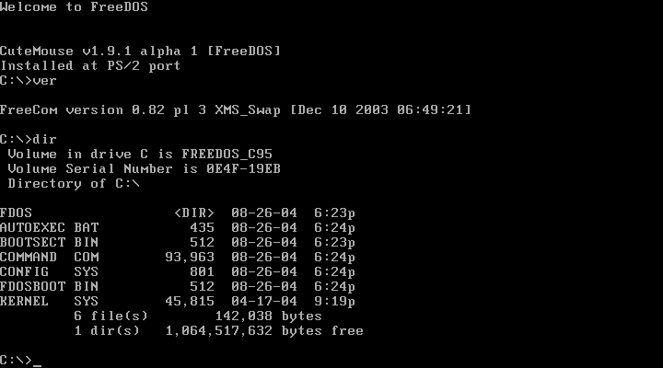
Based on user interface - text/character
Older operating systems used to use this method, but today's systems that use a graphical user interface.
It also generally provide the option of a so-called command-line mode, where commands can be given in a text interface.
Examples are Unix and Linux systems. In the past (before 1998) the DOS operating system was also used on desktop computers.
Notes:
- Advantage -> simplicity of implementation and the possibility to formulate instructions precisely
- Disadvantage -> it is important to be precise and therefore the commands need to be known exactly in order to be used.
If a command starts a program, the screen may display the user interface for that program, but when the program is finished, the operating system user interface will reappear.
The user types a command on the keyboard and the operating system's text response is displayed on the screen.

Slide 8
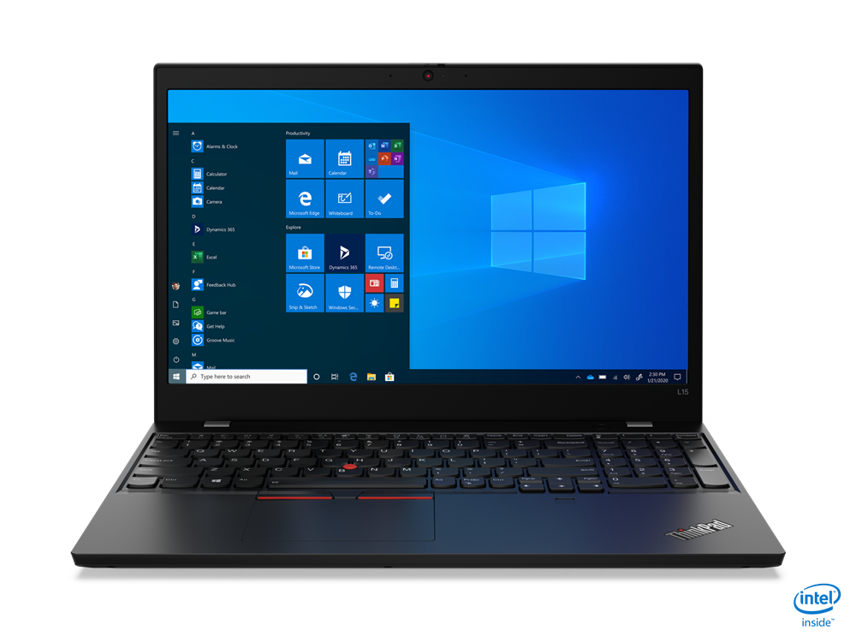
Based on user interface - graphical user interface
From a graphical interface, a keyboard can be used, but the typical input device is the mouse, which is represented on the screen by a pointer, usually in the form of an arrow.
You give the system instructions by moving the mouse over the objects and clicking on them.
Some examples are Windows operating systems, Macintosh operating systems and all Linux distributions.
Notes:
The advantage is that it is easier to use, the disadvantage is that
Advantage -> it is easier to use
Disadvantage -> the graphical display requires a
larger code size and memory usage, so it is slower than the text mode.

Slide 9
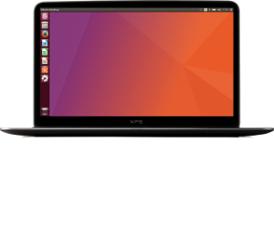
Based on source code - open source
People who use these kind of systems can make the system more complete and fix bugs that they discovered,
They can make the system faster and more stable,
People also share there own ideas and developments for free,
Perfect example is the Linux operating system which has started to be developed in several directions and has therefore evolved over the years into several distributions (Debian, RedHat, SuSe, Ubuntu, etc. ).

Slide 10
Based on source code - Closed
The operating system is developed by a company that has the closed source code and spends a lot of money on development, testing, bug fixing and marketing.
Such programs have to be paid for. It has to be purchased separately for each computer on which it is installed. This means that you have to buy as many licenses as you want to install. An example is the Windows operating system from Microsoft.

Slide 11
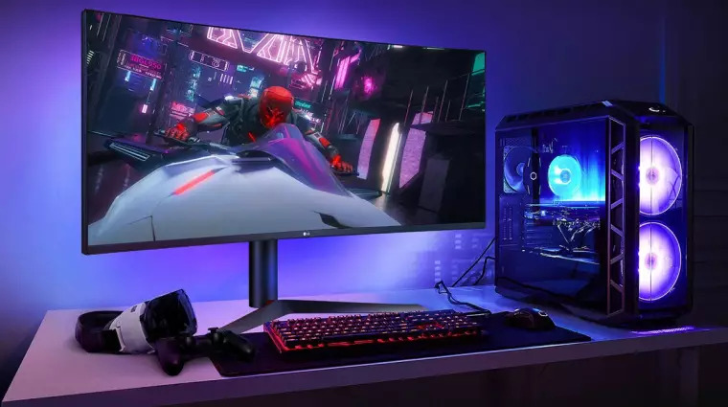
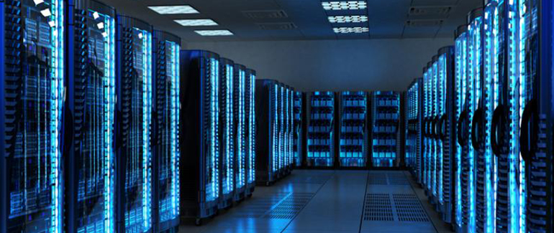
Grouping operating systems -by the method of use
Desktop computers
It typically runs user applications. The operating system is designed to serve user applications in the most optimal way.
Server computers
Network operating systems are based on a server/client architecture, where the server allows multiple clients to share resources.

Slide 12
Mostly known / Newest operating systems

Slide 13
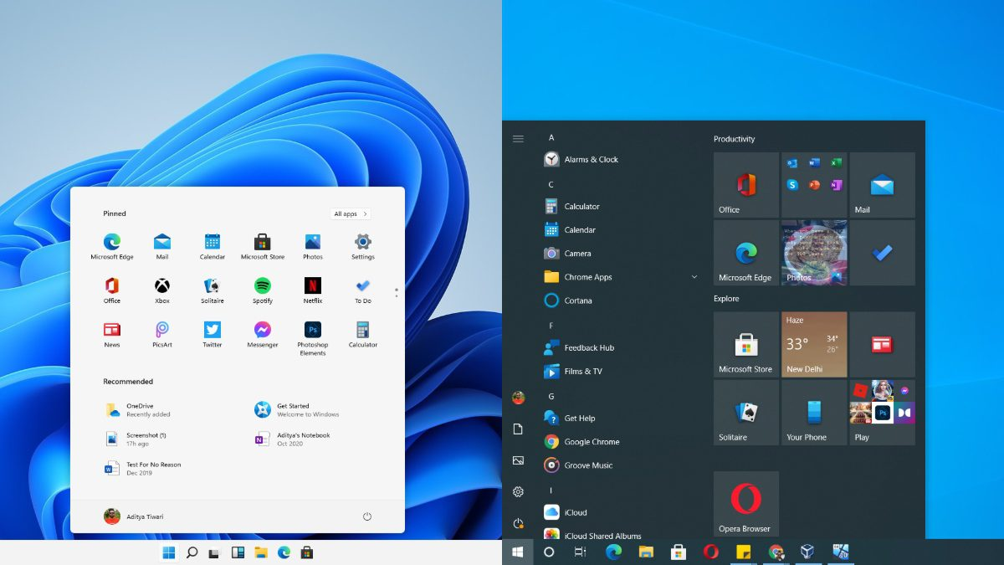
Mostly known / Newest operating systems - Desktop operating systems
Apple:
macOS (Big Sur) 11
(November 12 2020)
macOS (Monterey) 12
(October 25 2021)
Microsoft:
Windows XP (October 25 2001)
Windows 7 (October 22 2009)
Windows 10 (July 29 2015)
Windows 11 (June 24 2021)

Slide 14
Mostly known / Newest operating systems - mobil operating systems I.
They are very similar in operation and architecture to their "desktop" counterparts, such as Windows or OS X. They are mainly focused on wireless connectivity and multimedia, being more consumer electronics than IT devices from the user's point of view, besides being a communication tool.
Google:
Android 12/13
Linux using kernel/Google Play
Apple:
IOS 15.4
Own products/ App Store

Slide 15
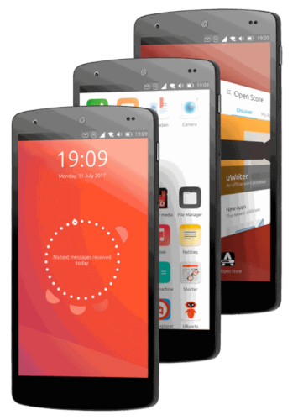
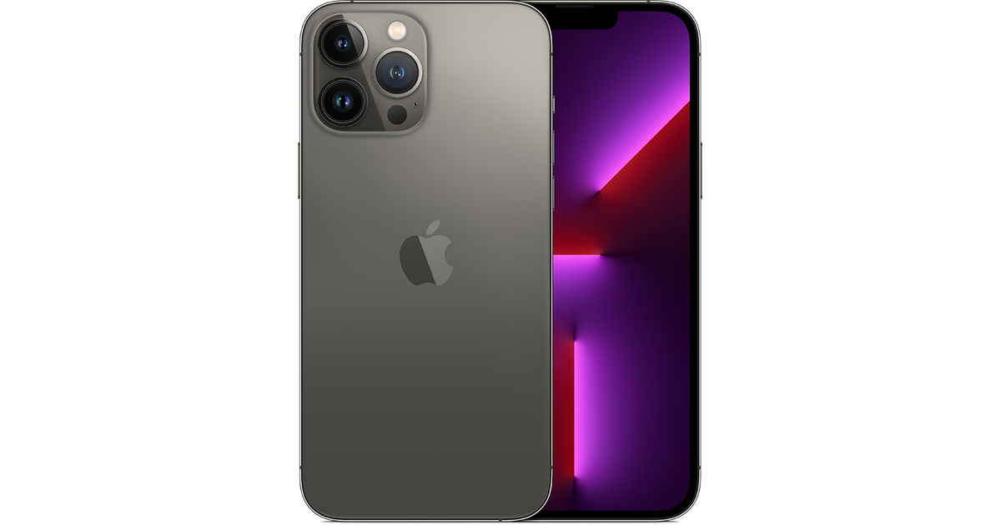
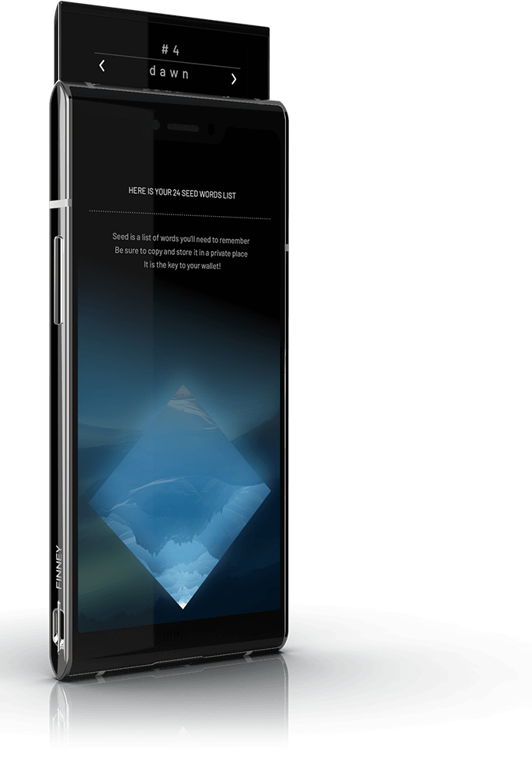
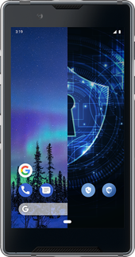
Mostly known / Newest operating systems - mobile operating systems II.
Finney U1
Android
Sirion OS
iPhone 13 pro
IOS 15.4
APP Store
Ubuntu Touch
Ubuntu 16.04

Slide 16
Thank you for your attention!

